Slide 1
Lesson 7
Initiating a Field Medical Card or
Tactical Combat Casualty Care Card

Slide 2
Task
Initiate a DD Form 1380, US Field Medical Card, or a DA Form 7656, Tactical Combat Casualty Care Card.
Conditions
Given information on a simulated casualty, a DD Form 1380 or a DA Form 7656, and a writing instrument.
Standards
Enter the required information in the appropriate blocks.
Score a GO on the written performance checklist.

Slide 3
Purpose of the Field Medical Card
Prepared on any casualty treated within a theater of operations.
Designed to be used in forward combat areas by NATO troops.
Provides medical personnel with essential information about the casualty’s injury and the treatment the casualty has already received.

Slide 4
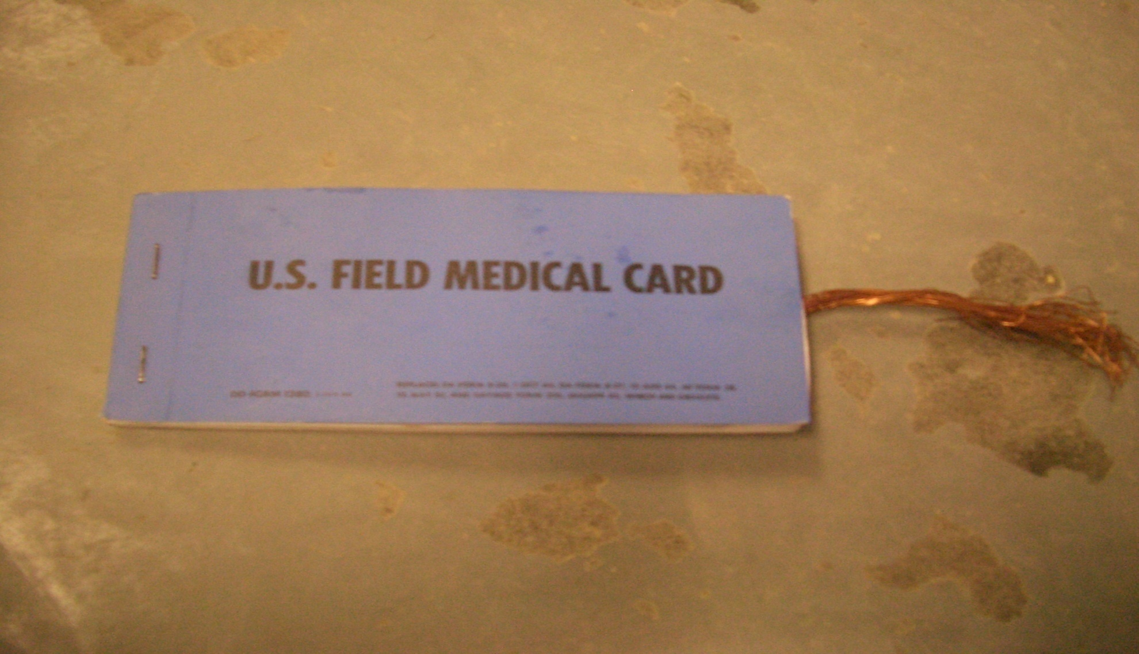
Field Medical Card Pad
Issued in Pads
Contains 10 sets

Slide 5
Initiating a Field Medical Card
Remove protective sheet
Enter primary information
Blocks 1, 3, 4, 9, & 11, if possible
Enter secondary information
Complete blocks 2, 5, 6, 7, 8, & 10 on the front side if appropriate and time permits.
Blocks 12-17 on the reverse side of the form are usually completed at the MTF.

Slide 6
Primary Information
Block 1
Name – Last Name, First Name, Middle Initial
Rank/Grade – abbreviation of casualty’s rank
Sex – mark appropriate box
Social Security Number (SSN) – enter casualty’s SSN
Military Occupation Specialty or casualty’s area of concentration
Religion – casualty’s religious preference
1. LAST NAME, FIRST NAME / NOM ET PRENOM
RANK/GRADE
MALE/HOMME
FEMALE/FEMME
SSN / NUMERO MATRICULE
SPECIALTY CODE / GPM
RELIGION/RELIGION

Slide 7
Primary Information
Block 3
Mark appropriate box to indicate type of injury
Battle Casualty (BC) – mark if suffering trauma
Nuclear, Biological, Chemical (NBC) – mark if NBC casualty
Disease – mark if casualty is ill but does not fit into any of the other three areas.
Psychological – mark if suffering from psychological injury or combat stress

Slide 8
Primary Information
Block 3
Use figures to show location of the casualty’s injury or injuries
One figure is for the front and one is for the back – correct anatomical position
Use “X” to denote the location of an injury or wound
Mark appropriate box or boxes on the right to describe the casualty’s injury or injuries.
Enter description if “OTHER” is checked.

Slide 9
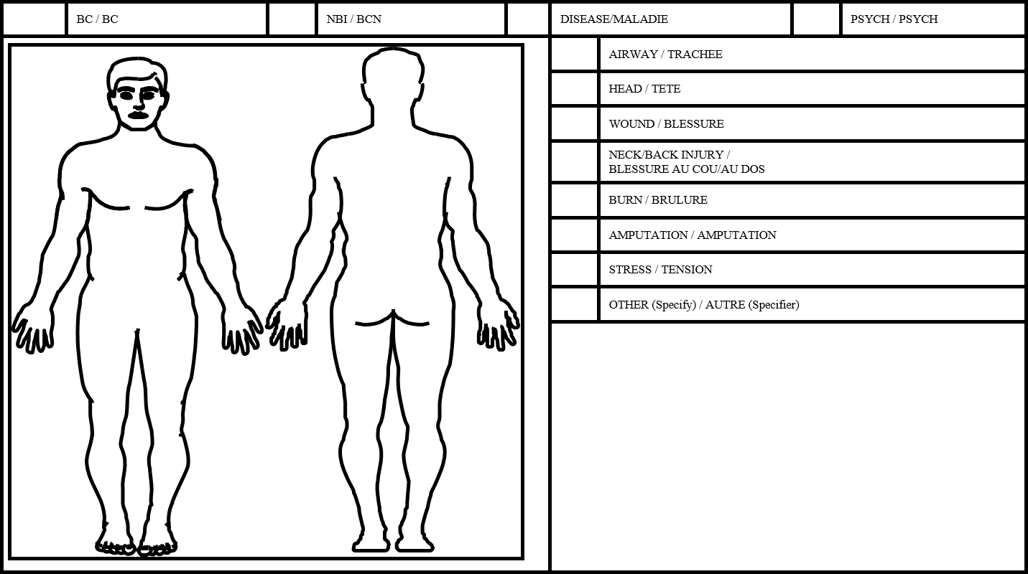

Slide 10
Primary Information
Block 4
Check appropriate box for level of consciousness.
Only check one box
A (Alert)
V (Verbal) – responds to verbal commands
P (Pain) – responds to painful stimuli
U (Unresponsive) – no response
4. LEVEL OF CONCIOUSNESS / NIVEAU DE CONSCIENCE
ALERT / ALERTE
PAIN RESPONSE / REPONSE A LA DOULER
VERBAL RESPONSE / REPONSE VEBALE
UNRESPONSIVE / SANS REPONSE

Slide 11
Primary Information
Block 9
Enter brief description of the treatment given
Use approved abbreviations
Use Block 14 if additional space is needed.
9. TREATMENT/OBSERVATIONS/CURRENT MEDICATIONS/ALLERGIES/NBC (ANTIDOTE)
TRAITEMENT/OBSERVATIONS/PRESENTE MEDICATION/ALLERGIES/ANTIDOTES
Multiple LW over anterior aspect of body due to hand grenade explosion. NKDA. Field dressings and pressure dressing applied.

Slide 12
Authorized Abbreviations
Abr W – Abraded Wound
Cont W – Contused Wound
FC – Fracture (compound) open
FCC – Fracture (compound) open comminuted
FS – Fracture simple (closed)
GSW – Gun Shot wound
LW – Lacerated wound
MW – Multiple wounds
Pen W – Penetrating wound
Perf W – Perforating wound
SV – Severe
SL - Slight

Slide 13
Primary Information
Block 11
Enter your initials in the far right of the signature block unless there is a combat medic present.
Do NOT sign
The medical officer is the only one who actually signs Block 11.
Do NOT enter anything in the date box.
This box is completed by the medical officer
11.PROVIDER/UNIT / OFFICIER MEDICALE/UNITE
DATE/DATE (YYMMDD)

Slide 14
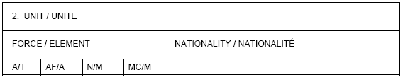
Secondary Information
Block 2
Enter casualty’s unit if known
Enter country of whose armed forces he is a member.
Check appropriate box to the armed service of which casualty is a member
“A/T” – Army
“AF/A” – Air Force
“N/M” – Navy
“MC/M” – Marine Corps

Slide 15
Secondary Information
Block 5 & 6
Mark “Yes” in Block 6 if a tourniquet is used.
If no tourniquet is used, leave block blank.
If “yes” is marked, indicate date (YYMMDD) and time (24 hour format)

Slide 16
Secondary Information
Block 7 & 8
Do NOT worry about Block 7 unless you are a medic
Leave blank
In Block 8, indicate type of IV fluid in the “IV” box and the date (YYMMDD) and time (24 hour format).
If no IV is administered, leave blank

Slide 17

Secondary Information
Block 10
Used to mark appropriate disposition of casualty.
Returned to Duty or Evacuated
Enter the date (YYMMDD) and time (military) of the disposition.

Slide 18
Reverse Side of the FMC
Normally filled out by medical personnel once casualty reaches MTF.
Use Block 14 if you run out of room on Block 9.

Slide 19
Attaching the FMC
Remove original card from pad
If casualty is RTD, do not remove card.
Attach card to casualty’s uniform and make sure it’s in plain sight.
Store pad

Slide 20
Tactical Combat Casualty Care Card
Most casualties injured on battlefield do not have documentation prior to evacuation.
DD Form is considered outdated and cumbersome to fill out by many.

Slide 21
TC3 Card
4.5-inch by 6-inch card based on the principles of TC3.
Addresses the initial lifesaving care provided at point of wounding.
Simple format using a circle or “X” in the appropriate block.

Slide 22
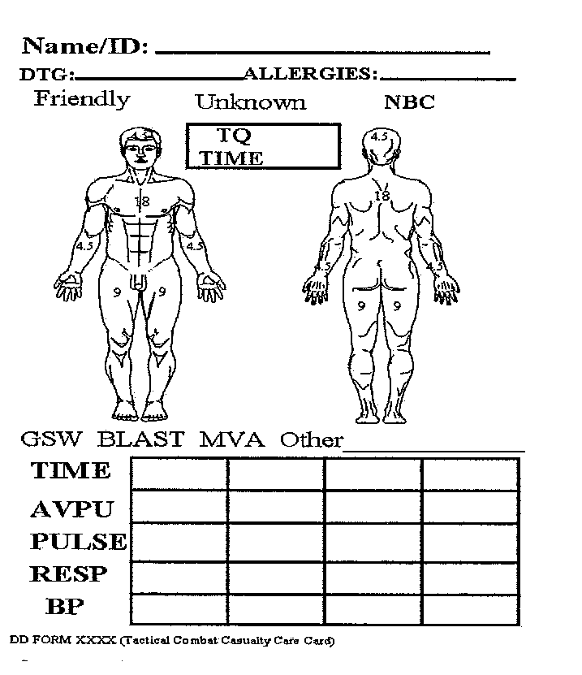
Front of the DA Form 7656

Slide 23
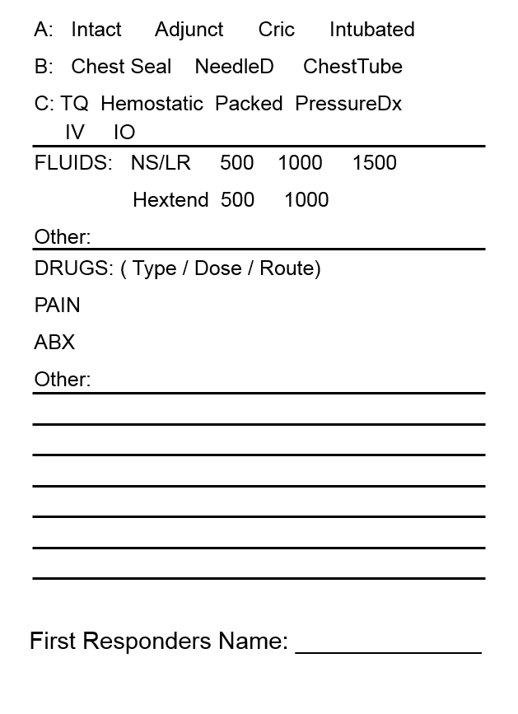
Back of the DA Form 7656

Slide 24
Each Soldier will carry his own in Improved First Aid Kit (IFAK)
Soldier should complete
Name/Unit Section
Allergies Section
Use indelible marker if possible

Slide 25
Completing the Front Side
Casualty’s Name (Name/Unit) – should be filled out by Soldier prior to placing in IFAK.
Obtain information from ID tags, uniform, or casualty himself if needed.
Allergies – should be listed by Soldier
Look for medical alert tags or ask casualty
Date-Time Group (DTG) – enter date and military time you begin treatment (i.e. 12JUL0800)
Cause of Injury – circle cause of injury.
Friendly (fratricide)
Unknown (most common one)
NBC (Nuclear, Biological, Chemical)

Slide 26
Completing the Front Side
Type of Injury – circle the type of injury.
If “other” is indicated, enter an explanation in the blank following “other”
Time tourniquet applied (TQ Time) – enter military time if tourniquet has been applied.
Location of Wound(s) – place “X” on illustration to indicate place of injury or injuries.
Percentages are used to estimate percentage of body surface burned.
Vital Signs – used to record casualty’s level of consciousness and vital signs.
use military time
Enter level of consciousness using AVPU
Enter casualty’s pulse rate (even number)
Enter casualty’s respiration rate (even number)
Enter casualty’s blood pressure if applicable

Slide 27
Completing the Reverse Side
Airway Interventions (Line A) – circle airway interventions performed
Intact – no airway intervention needed
Adjunct – circle if airway adjunct is used and enter brief explanation in “Other” section near bottom of card.
Cric – circle if cricothyrotomy is performed.
Intubaton- circle if a intubation is performed.

Slide 28
Completing the Reverse Side
Breathing Interventions (Line B) – circle any breathing interventions performed.
Chest Seal – circle if commercial chest seal has been applied
Needle D – circle if needle chest decompression is performed
Chest Tube - circle if chest tube inserted
Bleeding Control Measures (Line C) – circle appropriate bleeding control measures performed.
TQ – circle if tourniquet has been applied
Make sure time is entered in the “TQ Time”
Hemostatic – circle if hemostatic agent is used
Packed – circle if plain gauze has been packed in the wound
Pressure – circle if pressure dressing is applied

Slide 29
Completing the Reverse Side
Fluids Administered – circle “IV” (intravenous) or “IO” (intraosseous) to indicate method used to administer fluids.
Circle type of fluid administered & amount
“NS” for normal saline
“LR” for lactated ringer
“Hextend” for Hextend®
Enter Type or amount, if different from ones listed, in the “Other” line in Fluids
Drugs – “PAIN” – enter type, dose, & route of pain medications
“ABX” – enter type, dose, & route of antibiotics
“OTHER” – enter type, dose, & route of any other medication administered. This is where you enter combat casualty pill pack if administered.

Slide 30
Completing the Reverse Side
Notes – enter any pertinent information or observations
Signature – print name and rank in “First Responder’s Name” if no combat medic is present.

Slide 31
Attaching the Card
Attach the TCCC Card to the casualty
Place the card in the upper left sleeve or the left trouser cargo pocket of the casualty’s clothing

Slide 32
Questions?

Slide 33
TC3 CARD SCENARIO
You locate an injure Soldier on the battlefield at about 1600 hrs, 23 January 2013. When talking to the soldier, he tells you that he feels severe pain in his left shoulder, and that he feels that “someone pushed a stick completely through”.
He states his name is PV2 Joe Snuffy and that he is not allergic to anything that he knows of. Upon exposing the wound, you notice a through-and-through gunshot wound. To be on the safe side, you decide to apply an improvised occlusive dressing to both the entry and exit wounds. You also apply Emergency Trauma bandages with pressure bar to both wounds.
At 1615, you take a set of vital signs. His pulse rate is 72 beats/minute, respiration rate of 22 breaths/minute and he is still talking to you.
Prior to setting him up for evacuation, you administer his combat casualty pill pack and then get him loaded up on a CASEVAC.

Slide 34
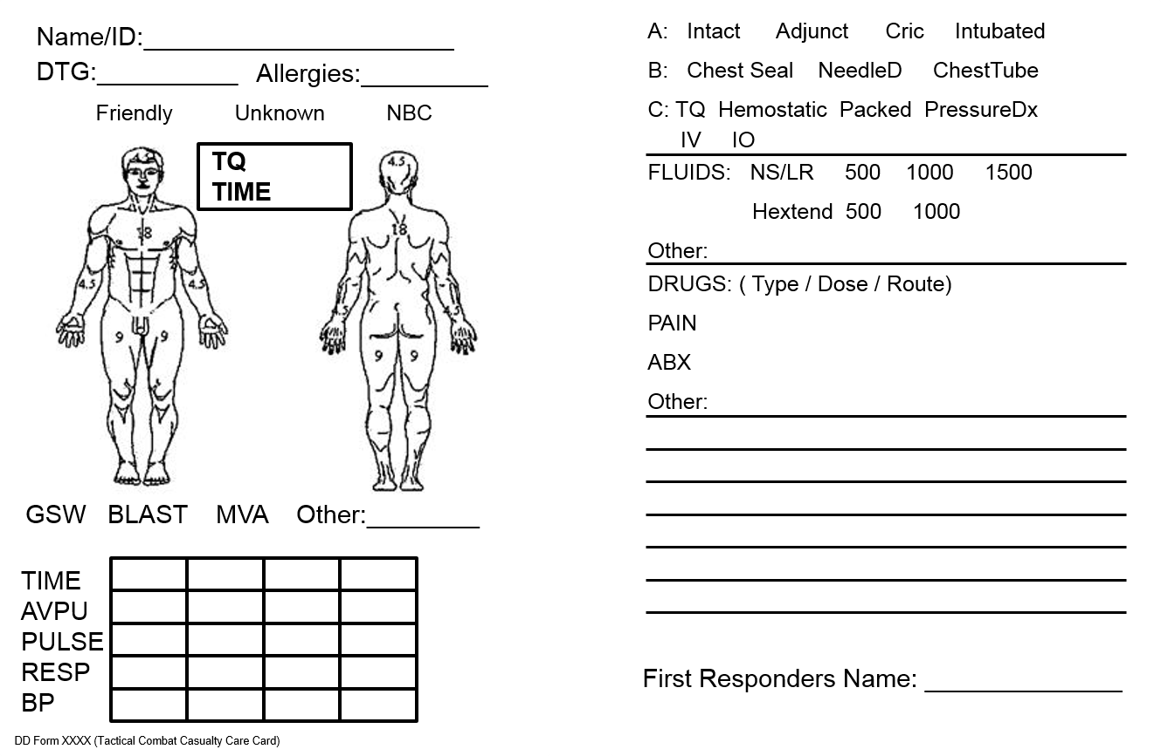
Snuffy, Joe
23 Jan 1600
NKA
Combat Pill Pack.
Applied occlusive dressings to both wounds.
Applied ETBs to both wounds.
1600
1615
A
A
72
22
Smith, John SSG

